Slide 1
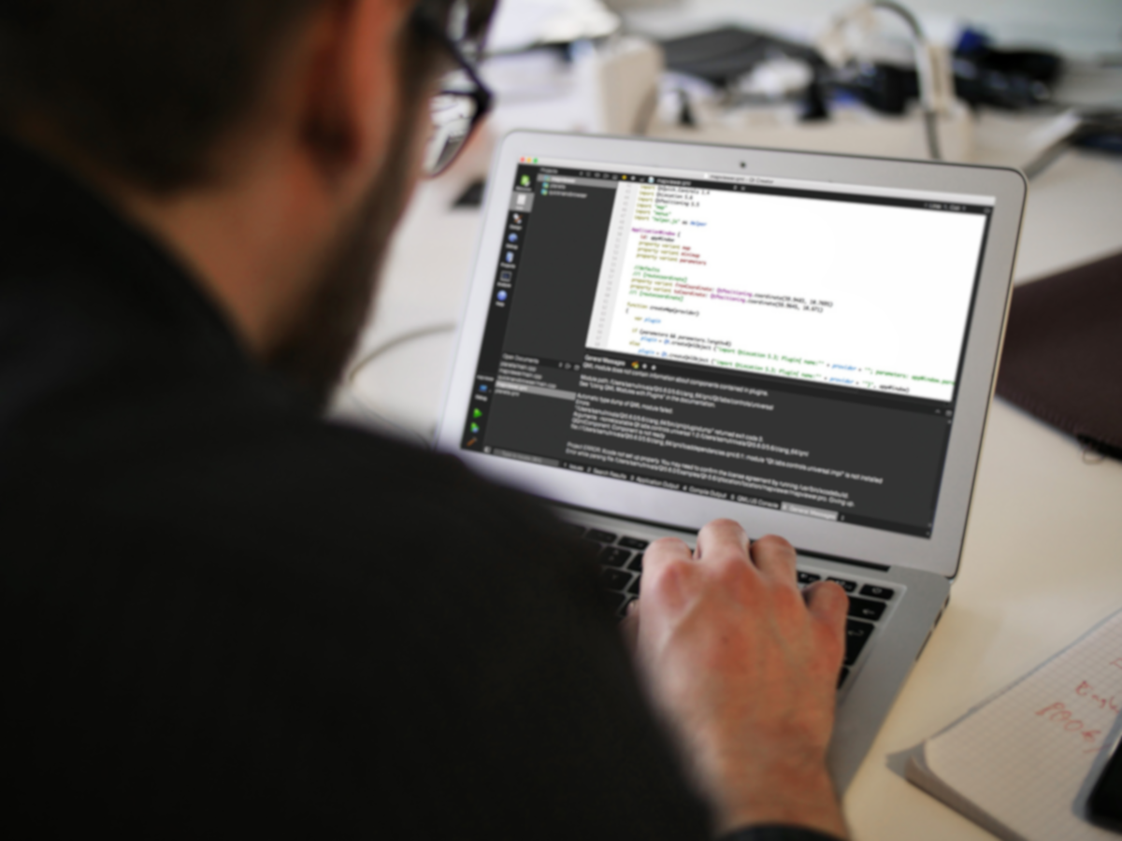
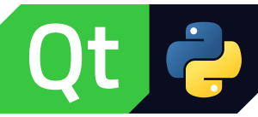
Qt for Python
Cross-platform GUIs for Python applications
August 6, 2019
Notes:
Intended audience is expected to know Python, but not necessarily Qt.

Slide 2
Python is great
Python:
Powerful cross-platform programming language
Friendly and easy to learn
Very popular and growing fast
Huge community
Numerous value-adding libraries easily available
Abundance of examples and tutorials
Help, support and discussion forums
Can be challenging to find suitable GUI library
Tiobe index – June 2018
Indeed job openings – Dec 2017
Notes:
Python is a great programming language, but
There is no intrinsic mechanism to create graphical user interfaces
If GUIs are required, the programmer must use external libraries
WxPython
Kyvi
PyGObject
Qt
Etc.
Not all of these are suitable for every application
Qt is the only framework backed by professional company and a huge community

Slide 3
Python – UI Frameworks
Numerous GUI libraries available
Most developed by smaller communities
Notes:
There are several GUI frameworks for Python to chose from
wxPython
PyGObject
tkInter
Kivy
++
These are usually GUI only, some are not cross-platform or has limited number of supported platforms, developed by smaller communities and lack professional support.

Slide 4
Qt for Python
GUI
Qt for Python
Qt – C++ framework
PySide2 – Python module
PySide2 - Bindings between Python and Qt
Python developers can leverage the power of Qt
Bringing Qt to the Python environment
Easily installed through Python Package Index, PyPI
Familiar development environment
Qt
(Qt 5.12+)
PySide2
Python
(Python 2.7, 3.5+)
Qt for Python
Notes:
Qt for Python consists of three main modules
The Qt framework itself
PySide, the Python module used by the Python application
Shiboken
Not required for, but used by Qt for Python
Binding generator used to create the bindings used in the PySide module. Shiboken was created by The Qt Company for the PySide project, but is available for everyone who would like to create bindings from any C++ library

Slide 5
So, What is Qt
Cross-Platform
Professional Support
All-in-one framework
Powerful & modern development framework
UI creation
Highly performant
Productive development environment
Cross-platform IDE – Qt Creator
Professional support and services
Large developer community
Community
Professional Tools
Notes:
Qt is one of the most comprehensive cross-platform frameworks available
GUI creation: widgets, Quick and QML
Numerous other functional modules
True, there are several other GUI frameworks available for Python
Kyvi, WxPython, etc.
Qt is the only framework backed by a professional company and a large developer community
Professional productivity tools part of the offering
Access to professional support and large developer community
The best option for creating GUIs in Python applications

Slide 6
Demo
#!/usr/bin/python
from PySide2.QtWidgets import QApplication, QMessageBox
# Create the application object – necessary!
app = QApplication([])
# Create a simple dialog box
msg_box = QMessageBox()
msg_box.setText("Hello World!")
msg_box.show()
msg_box.exec_()
https://wiki.qt.io/Qt_for_Python_Tutorial_HelloQMessageBox
Notes:
Qt is one of the most comprehensive cross-platform frameworks available
GUI creation: widgets, Quick and QML
Numerous other functional modules
True, there are several other GUI frameworks available for Python
Kyvi, WxPython, etc.
Qt is the only framework backed by a professional company and a large developer community
Professional productivity tools part of the offering
Access to professional support and large developer community
The best option for creating GUIs in Python applications

Slide 7
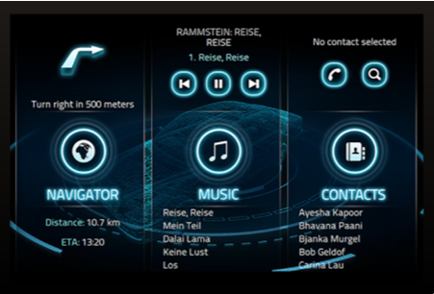
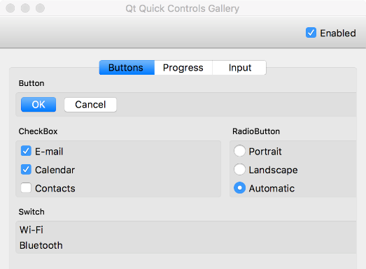
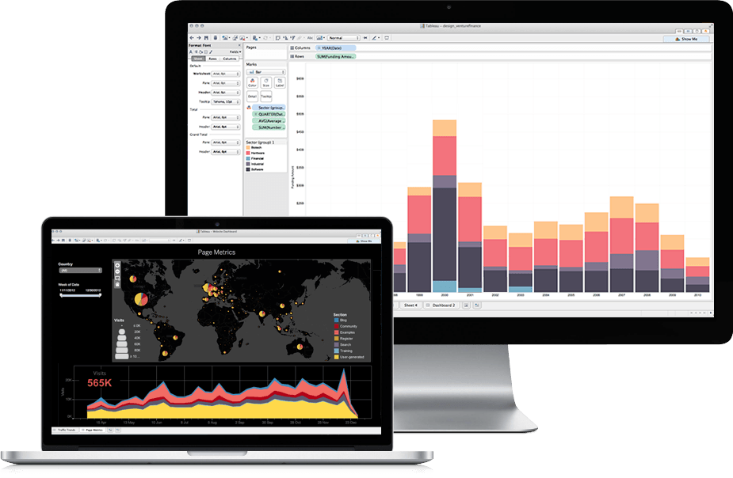
Qt UI Offering – Choose the Best of All Worlds
Declarative / QML
Qt Quick declarative UI design (QML) for beautiful, modern touch-based user experiences.
Qt Quick Controls
Customizable easy-to-use controls for beautiful, modern touch-based user experiences
Qt Widgets
Customizable UI widgets for traditional desktop look-and-feel..
Notes:
Qt Quick is the high-end way for creating UIs with Qt. It allows the UI layout (the presentation layer of the software) to be created with a high-level declarative language, QML, which is specifically designed for creating modern, touch-based UIs with view transitions and animations. In the back, it still has all the power of C++ in performance/device access. Qt Quick usually requires OpenGL ES 2 support from the device, at least to run properly.
The other used option is Qt Widgets, that is available for a wider set of devices and operating systems, as it doesn’t require for OpenGL support. The Qt Widgets are mostly used in desktop UIs, but they can be easily styled into embedded UIs as well—however, providing a bit more static UI layout.

Slide 8
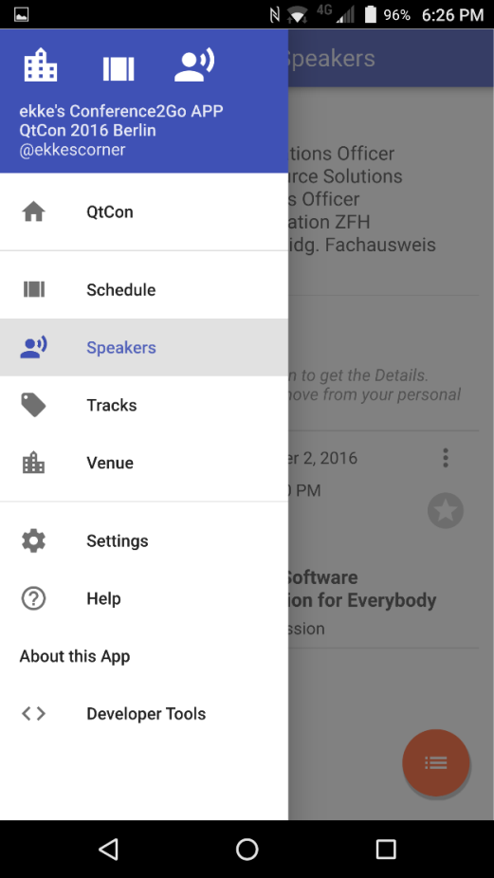
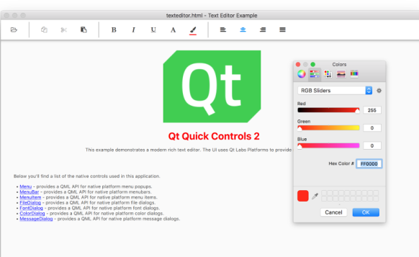
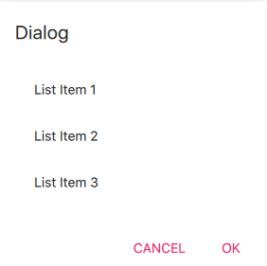
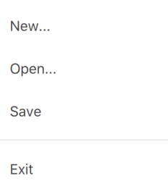

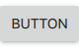


Productivity Out of the-Box – Qt Quick Controls
Main window
Dialog
Menu
Menu separator / Tool separator
Slider
Buttons / Switches
Menu container
Notes:
Library of UI controls (buttons, sliders, dials, etc.) for Qt Quick
A new project, re-thinking the controls
Sleek, performant, easily customizable
Divided into Templates (basis) and an existing set of Controls (example set, using Flat Style)

Slide 9
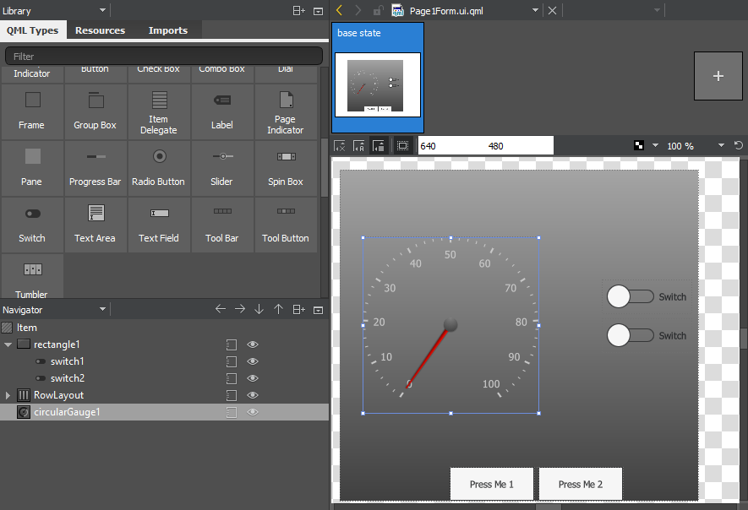
Qt Quick Designer – Functionality Meets Design
Visual drag’n’drop UI editor
Built-in to Qt Creator
Designer-friendly
Integrated Qt Quick Controls
Rapid way for UI design
Seamless designer-developer workflow
Separated UI presentation from UI logic
Notes:
One of the tools inside Qt Creator that has gotten a lot of improvements over the past versions is the Qt Quick Designer. This is a drag’n’drop visual editor for Qt Quick, in a similar way than Qt Designer is for Qt Widgets.
With Qt Quick Designer, you can drag’n’drop your UI layout using the Qt Quick Controls, and now, with Qt 5.7, it contains all the new Qt Quick Controls 2. You can manage their hierarchy, properties and directly connect them to each other. It also separates the UI presentation, the UI form files, from the UI logic, so that you don’t need to work directly with generated code.
With Qt Creator and Qt Quick Designer, you can easily do rapid UI prototyping. Modify and tweak your UI visually, and with a single click from Qt Creator, you can then immediately deploy the new outcome to a desktop application or directly into your embedded device.
Drag’n’drop all Qt Quick Controls, manage their hierarchy , layout, properties and directly connect them to each other.

Slide 10
Qt for Python – More Than What Meets the Eye
Qt Quick
Qt X11 Extras
Qt OpenGL
Qt 3D Core
Qt WebChannel
Qt TextToSpeech
Qt Quick Widgets
Qt Mac Extras
Qt SVG
Qt 3D Input
Qt WebSockets
Qt SCXML
Qt Widgets
Qt Windows Extras
Qt Charts
Qt 3D Logic
Qt Network
Qt XML & XML Patterns
Qt QML
Qt UiTools
Qt Data Visualization
Qt 3D Animation
Qt Concurrent
Qt SQL
Qt Core
Qt AxContainer
Qt Multimedia Widgets
Qt 3D Extras
Qt Location
Qt Test
Qt GUI
Qt Print Support
Qt Multimedia
Qt 3D Renderer
Qt Positioning
Qt Sensors
Notes:
Huge collection of modules that can be used to create user interfaces
2D and 3D
Widgets targeting desktop UIs
Quick and QML targeting mobile and embedded UIs
In addition, Qt offers several other value-adding cross-platform modules:
Network, sockets and web interaction
Sensors (e.g. ambient light, compass)
Location and Positioning (maps, GPS)
Text-to-Speech
XML manipulation
State machine with SCXML support
Multimedia
Data analysis and presentation (charts)
Many of the functions offered in Qt are also available through other Python libraries. With Qt you’ll get all in one package, supported by a professional company

Slide 11
Additional Resources
Docs
https://doc.qt.io/qtforpython/
Wiki: Qt For Python
https://wiki.qt.io/Qt_for_Python
Tutorial For Building A Python Chat App
https://build-system.fman.io/python-qt-tutorial
ICS Qt For Python On-Demand Webinar
https://www.ics.com/webinar/qt-python
Using QML with Python
https://qmlbook.github.io/ch18-python/python.html
Notes:
Qt is one of the most comprehensive cross-platform frameworks available
GUI creation: widgets, Quick and QML
Numerous other functional modules
True, there are several other GUI frameworks available for Python
Kyvi, WxPython, etc.
Qt is the only framework backed by a professional company and a large developer community
Professional productivity tools part of the offering
Access to professional support and large developer community
The best option for creating GUIs in Python applications

